Slide 1

Data Curation Project
Team members:
Satya Nandikeswara rao Chinta, A20516065
Bavith Kumar Reddy Komtireddy, A20518408
Kareem Ahaan, A20513492

Slide 2
Outline:
Introduction to the Dataset
Dataset Information
Overview of Data Quality Problems
Methodology and Tools for Data Quality Assessment
Strategies to Overcome Data Quality Issues
Challenges Faced
Results and Improvements

Slide 3
1. Introduction to the Dataset
The dataset we are using is Data Science Job posting file which are job posts on Glassdoor. The data was scrapped from glassdoor's website. Kaggle served as a reliable platform for accessing datasets, ensuring transparency and reproducibility.
The dataset has 672 rows and 15 columns.
Why This Dataset?
The dataset provides valuable insights into the evolving field of data science employment. Analyzing job postings helps identify trends, skills in demand, and the geographical distribution of opportunities.
Domain: Employment and Data Science Job Market
Focus on the intersection of employment and the data science job market. Gain a nuanced understanding of the skills, qualifications, and expectations outlined in data science job postings.

Slide 4
Dataset Information:
Columns | Description
Index | Unique identifier for each job posting.
Job Title | Title or designation associated with the job.
Salary Estimation | Range of potential salaries for the job.
Job Description | Comprehensive description detailing the job's responsibilities and requirements.
Rating | The rating assigned to the job posting.
Company | Name of the hiring company.
Location | Geographical location of the company.
Headquarters | Headquarters' location of the company.
Size | The total number of employees within the company.
Founded | Year in which the company was established.

Slide 5
Dataset Information:
Columns | Description
Type of Ownership | Describes the company's ownership type (e.g., non-profit, public, private, etc.).
Industry | Specific industry field the applicant will be working in.
Sector | The sector classification of the company.
Revenue | Total revenue earned by the company.
Competitors | List of competitors associated with the respective company.

Slide 6
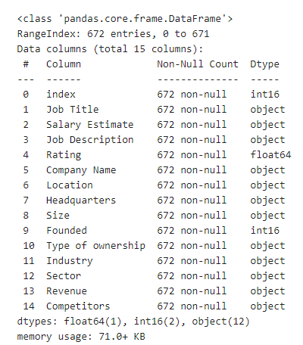
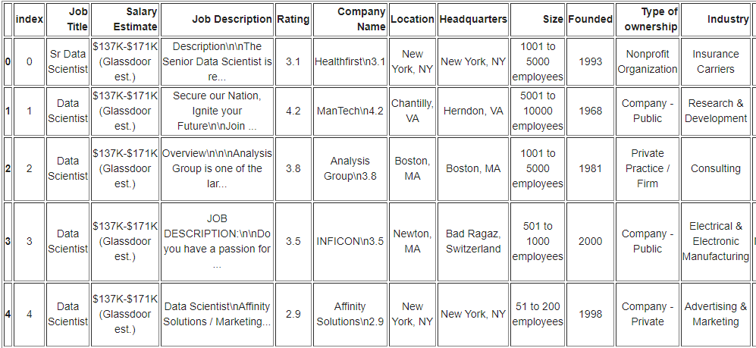
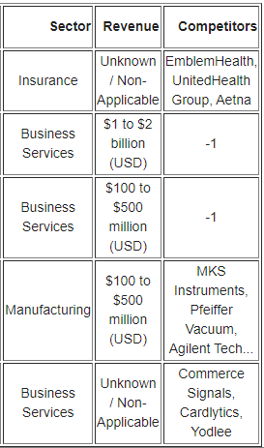
Dataset Information:

Slide 7
Overview of Data Quality Problems:
Irrelevant Fields such as Index, Job Description and Competitors.
Multiple columns with wrong data types such as Salary Estimate, Rating, Revenue and Size.
Data inconsistency where multiple columns have -1 and unknown making them all string datatype. Company name column includes rating at the end of the string for every row.
Multiple columns can be separated like Location and headquarters into city and state.
Size and Revenue column has value as range of employees and range of Revenue.

Slide 8
Methodology and Tools for Data Quality Assessment:
Vizier:
Our interactive and collaborative platform for seamless integration of code, visualizations, and documentation. Enabled efficient analysis and iterative exploration of data quality challenges.
Pandas and NumPy:
Utilized Pandas for exploratory data analysis, handling missing values, and performing statistical computations.
NumPy supported numerical operations and array manipulations essential for data quality assessment.

Slide 9
Strategies to Overcome Data Quality Issues:
Index is an irrelevant column and can be removed.
Job Title name can be changed without space for easy manipulation. It can be divided into 2 columns as Job_sim and Job_level which represent the simple job title and job level.
Salary Estimation name can be changed without space for easy manipulation.It can be divided into 3 columns as min_salary, max_salary and avg_salary as int columns which changing the Salary Estimate columns as string but in range.
Description has been removed because of complexity.
Rating Column needs to be changed to real and few values are -1. They are changed to 0 which means unknown or not rated.
Company Name has company name and rating in next line. so, rating needs to be removed from the column.
Location can be divided into Location and Location_State.
Headquarters can be divided into Headquarters and Headquarters_State.
Size of Employees is given as string and in range. So, we decided we leave them as range and if there are -1 values then they are changed to Unknown.
Founded has -1 values which are unknown values. We decided not make any changes.
Type of Ownership, Industy and Sector have both -1 and Unkown as values. So, we changed all -1 values to Unknown.
Revenue can be divided into 2 columns where revenue will stay as string and revenue_average will have average of revenue in millions.
Competitors have been changed to count of competitors instead of names of competitors.

Slide 10
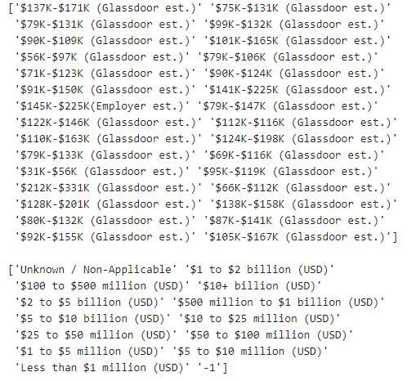
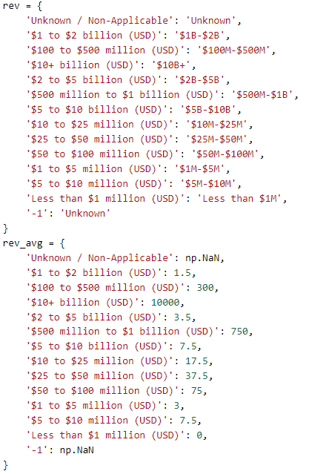

Slide 11
Challenges Faced
We proposed to extract Requirement and skills field from the Job Description column, but the description was different for each row and was tough to extract useful data. So, we decided on dropping the column for now.
Size of employees has a field where the employee number was 10000+ and unknown values were represented as –1. So, instead of making the number of employees to int we kept them as string and gave the max employee value for each row and unknown in place of –1.
Similarly, for revenue we have kept it as string but added extra column revenue_average as int with average of revenue.

Slide 12
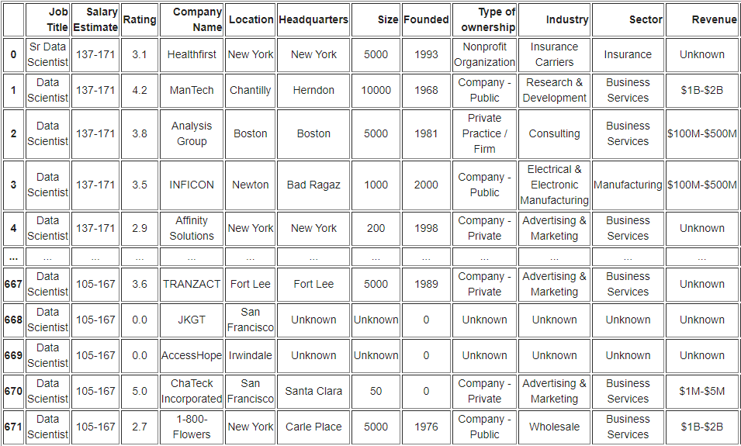
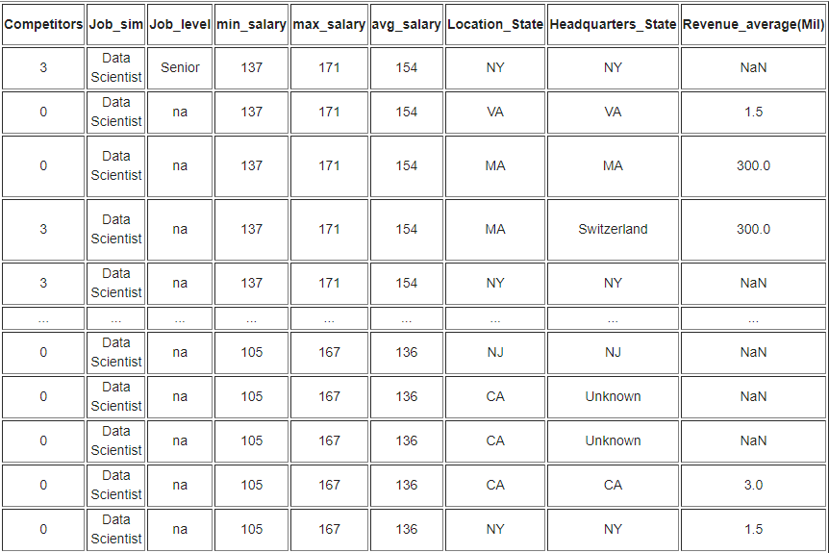
Results

Slide 13
Conclusion
Insightful Exploration:
Our analysis delved into the nuances of data science job postings, offering valuable insights into industry trends and demands.
Data Quality Challenges Addressed:
Through robust methodologies and tools like Pandas, NumPy, and the Vizier Notebook, we navigated and addressed various data quality challenges.
Reliability of Findings:
By mitigating missing values, inconsistencies, we ensured the reliability and accuracy of our findings.

Slide 14
References
Dataset: https://www.kaggle.com/datasets/rashikrahmanpritom/data-science-job-posting-on-glassdoor/data?select=Uncleaned_DS_jobs.csv
https://github.com/IITDBGroup/cs520/blob/master/vizier/README.md

Slide 15
Thank You! Q&A

